Slide 1
A Journey Through English Literature
Exploring the evoluation of English literature from its origins to modern masterpiceces

Slide 2
Submited By ,
Effat Jahan Ema
Department of English
University of Barishal

Slide 3
Introduction:
the body of written works produced in the English language by inhabitants of the British Isles (including Ireland) from the 7th century to the present day. The major literatures written in English outside the British Isles are treated separately under American literature, Australian literature, Canadian literature, and New Zealand literature. English literature has sometimes been stigmatized as insular.

Slide 4
Prose and poetry
From settlement to 1900
The first writers of English in Canada were visitors—explorers, travelers, and British officers and their wives—who recorded their impressions of British North America in charts, diaries, journals, and letters..
Canadian literature, the body of written works produced by Canadians. Reflecting the country’s dual origin and its official bilingualism, the literature of Canada can be split into two major divisions: English and French. This article provides a brief historical account of each of these literatures. The earliest documents were unadorned narratives of travel and exploration

Slide 5
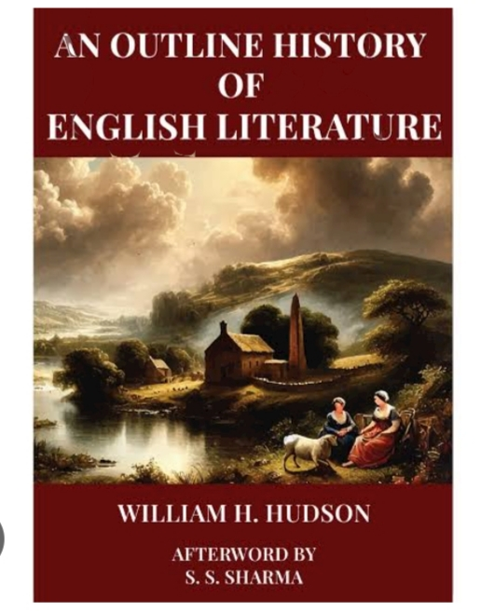
Frances Brooke, the wife of a visiting British military chaplain in the conquered French garrison of Quebec, wrote the first published novel with a Canadian setting. Her History of Emily Montague (1769) is an epistolary romance describing the sparkling winter scenery of Quebec and the life and manners of its residents

Slide 6
Conclusion:
Most of the earliest poems were patriotic songs and hymns (The Loyal Verses of Joseph Stansbury and Doctor Jonathan Odell, 1860) or topographical narratives, reflecting the first visitors’ concern with discovering and naming the new land and its inhabitants.

